Slide 1
Measuring Out-Patient Satisfaction of Lotus Hospital
Polkam Sridevi
[22401024]

Slide 2
Outline of presentation
Introduction
Objectives
Hypothesis
Data Analysis
Factor Analysis
Linear Regression
Findings & Suggestions
Conclusion
Demographics

Slide 3
INTRODUCTION
This project explores the relationship between out-patient feedback and satisfaction in healthcare.
Patient feedback is a vital resource for evaluating service quality, and satisfaction is the ultimate goal of healthcare delivery.
Analyzing this correlation through data-driven approaches will provide evidence-based recommendations for improving healthcare services with a focus on enhancing healthcare quality and patient-centered care.

Slide 4
Objectives
To study the conceptual understanding of patient Satisfaction.
To identify the Critical Factors of Patient Satisfaction at Lotus Hospital.
To examine the level of Patient Satisfaction at Lotus Hospital.

Slide 5
Data Analysis
Primary data is collected from the patients, post their OP consultation, using a 3rd party software called “Treatwell”.
Collected Data is a real time data from 21 August 2023 to 20 September 2023
Tools used for Analysis are :
1. Excel
2. BlueSky statistics

Slide 6
Features
Dependent variable: Overall satisfaction
Independent variables:
Appointment Experience(Primary Keyword)
OPD Reception(Primary Keyword)
Doctor's Experience(Primary Keyword)
Laboratory Services(Primary Keyword)
Time taken for registration
Radiology Services(Primary Keyword)
Housekeeping & Facilities(Primary Keyword)
Parking and Security(Primary Keyword)
I will recommend Lotus Hospital(Primary Keyword)
Courtesy of reception staff and Lab staff
Explanation to your queries

Slide 7
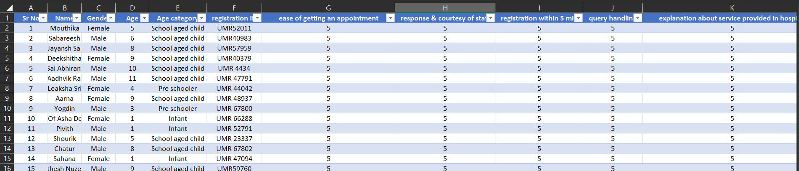
DATASET
No. of rows = 335 No. of entries = 335
No. of columns =29

Slide 8
NPS CATEGORY DISTRIBUTION
NPS | Count of NPS
Detractors | 0.60%
Passives | 14.93%
Promoters | 84.48%

Slide 9
Demographics
Gender
Gender | Count of Gender
Female | 48.96%
Male | 51.04%
Grand Total | 100.00%

Slide 10
Age
Age Group | Count of Age
Infant | 23
Pre schooler | 41
School aged child | 192
Teens | 56
Toddler | 23
Grand Total | 335

Slide 11
Age group vs NPS
Age Group | Detractors % | Passives % | Promoters % | Grand Total %
Infant | 0.00% | 0.90% | 5.97% | 6.87%
Pre schooler | 0.30% | 1.79% | 10.15% | 12.24%
School aged child | 0.30% | 8.66% | 48.36% | 57.31%
Teens | 0.00% | 2.39% | 14.33% | 16.72%
Toddler | 0.00% | 1.19% | 5.67% | 6.87%
Grand Total | 0.60% | 14.93% | 84.48% | 100.00%
(0 -1) - Infant
(1 – 2) – Toddler
(3 – 4) – Pre schooler
(5 – 12) – Schooled aged child
(13 – 15) - Teens

Slide 12
Age group vs Gender vs Satisfaction
Age Group | Satisfaction in Female % | Satisfaction in Male % | Grand Total %
Infant | 4.08% | 4.08% | 8.16%
Pre schooler | 6.12% | 6.80% | 12.93%
School aged child | 29.25% | 28.57% | 57.82%
Teens | 4.76% | 8.16% | 12.93%
Toddler | 1.36% | 6.80% | 8.16%
Grand Total | 45.58% | 54.42% | 100.00%

Slide 13
Factor Analysis
 | Factor1 | Factor2
SS loadings | 12.3140 | 1.0870
Proportion Var | 0.6480 | 0.0570
Cumulative Var | 0.6480 | 0.7050

Slide 14
Hypothesis Testing
 | Values
Chi-sq statistic | 820.7800
Degress of freedom | 134.0000
P-value | 3.8000e-99
The chi square statistic is 820.78 on 134 degrees of freedom. The p-value is 3.8000e-99

Slide 15
Linear Regression
LM Summary
Residual Std. Error | df | R-squared | Adjusted R-squared | F-statistic | numdf | dendf | p-value
0.3278 | 144 | 0.7063 | 0.7022 | 173.1266 | 2 | 144 | p-value < 2.2e-16
Residuals
Min | 1Q | Median | 3Q | Max
-0.8211 | -0.1147 | -0.0298 | 0.0545 | 0.9623

Slide 16
Coefficients
 | Estimate | Std. Error | t value | Pr(>|t|) | 2.5 % | 97.5 %
(Intercept) | 0.4543 | 0.2257 | 2.0131 | 0.0460 * | 0.0082 | 0.9003
Employee.Efficiency | 0.3373 | 0.1470 | 2.2944 | 0.0232 * | 0.0467 | 0.6280
Patient.Relationship.Practices | 0.5778 | 0.1454 | 3.9743 | 0.0001 *** | 0.2904 | 0.8651

Slide 17
Findings
84% are promoters
14% are passives
Male footfall ratio (51%) is higher than the female ratio (48%)
School aged child group has highest promoters followed by teens respectively
Females of School aged child group is having higher satisfaction than males
Infant and toddler group are having same satisfaction levels
There are people who are dissatisfied with some or the other services provided at Lotus hospital but still they are promoters
The critical factors are Employee efficiency and Patient Relationship Practices.

Slide 18
Suggestions
Services that need immediate attention are:
Parking
Pharmacy
Housekeeping
Reception
Overall Suggestion:
Reduce wait time
Improve basic services

Slide 19
Conclusion
In light of these findings, it is evident that Children's Hospital has several strengths that contribute to positive patient experiences.
However, there are areas for improvement, particularly in enhancing the parking, housekeeping, courtesy and competency of staff, and addressing specific feedback from patients.
Therefore, by examining outpatient satisfaction, this project aims to provide valuable insights that can drive improvements in healthcare services, foster patient engagement, and contribute to a more patient-centered healthcare system.

Slide 20
Thank you

